Slide 1

Entrepreneurship
-Jasbir Singh Bhatia
-Vishesh Pahuja

Slide 2
“Definition”
"A person who organizes and manages any enterprise, especially a business, usually with considerable initiative and risk".
Seen as a business leader and innovator of new ideas and business processes.

Slide 3
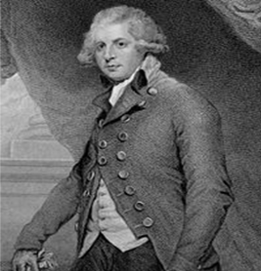
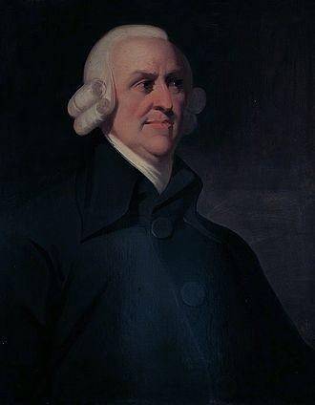

“History”
Entrepreneur is a word adopted from French, first used in 1723.
Historically the study of entrepreneurship reaches back to the work in the late 17th and early 18th centuries of Richard Cantillon and Adam Smith, which was foundational to classical economics.
Richard Cantillon
Adam Smith

Slide 4
Entrepreneurial Start-Up Process
The Entrepreneur
The Environment
The Opportunity
Start-Up Resources
The New Venture Organisation

Slide 5
“Questions to keep in mind”
What are my motivations for owning a business?
Should I start or buy a business?
What and where is the market for what I want to sell?
How much will all this cost me?
Should my company be domestic or global?

Slide 6
“Difference in Entrepreneurs”
Successful
Unsuccessful
Creative and Innovative
Position themselves in shifting or new markets
Create new products
Create new processes
Create new delivery
.
Poor Managers
Low work ethic
Inefficient
Failure to plan and prepare
Poor money managers

Slide 7
Trust your gut.
Keep your calm
Aim High
Keep trying
Analyse
Be Patient
Do
Don’t
Don’t follow the trend
Miss on loopholes
Don’t be careless
Dont be afraid to try

Slide 8
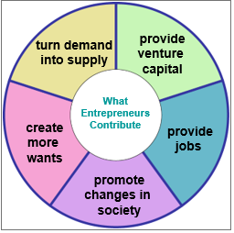
Contribution

Slide 9
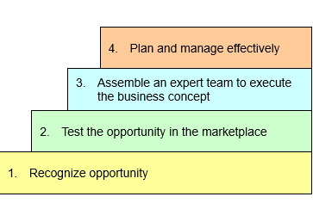
“Way to success”

Slide 10
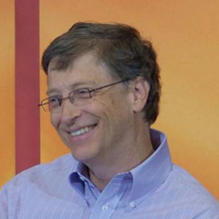
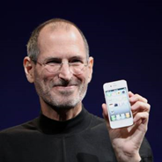

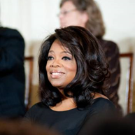




Top Entrepreneurs
Bill Gates
Steve Jobs
Elon Musk
Oprah Winfrey
“Microsoft Founder”
Net over $77 Billion
“Founder and CEO of Apple”
Net over $10.2 Billion
“Founder of Paypal, SpaceX and Tesla Motors”
Net $11.2 Billion
“Media Proprietor”
Net $3 Billion

Slide 11
“For me, Entrepreneurship is creating the difference i want to see in the world. It is my way of expression as an individual, towards the betterment of lifestyle and or work.”
Jasbir says

Slide 12
“Entrepreneurship to me is a way of being independent and growing simultaneously.
It shows the practicality of you,and helps you deal with risks”
Vishesh says

Slide 13
Books for reference
Art of The Start 2.0 by Guy Kawasaki
The World’s Greatest Speeches
Connect by John Browne
How to Win Friends & Influence People by Dale Carnegie

Slide 14
Thank
You

